Slide 1
Intro to Amazon QuickSight
AWS Kennesaw Meetup
July 13, 2017

Slide 2
Agenda
Intro
What is Amazon QuickSight?
Demo Scenario
Connecting to Data Sources
Shaping Your Data
Visualizing Data
Publish and Share Your Results
Resources

Slide 3
About Me
Independent Business Intelligence/Analytics Consultant
MCP: Querying Microsoft SQL Server 2012
Member of TAG Data Science and Analytics Society Board
Active Volunteer with Atlanta Microsoft Database Forum (local PASS Chapter)
Organizing Committee for Atlanta SQL Saturday since 2010
Contact Info:
E-mail: eric@flammconsulting.com
Mobile: (678) 524-4256
Twitter: @eflamm
Web: www.flammconsulting.com

Slide 4

What is Amazon QuickSight?

Slide 5
What is Amazon QuickSight?
Native AWS Service that supports:
Cloud Analytics
Dashboards
Storyboards
No Server Licensing
No Infrastructure
Scalable
Intuitive User Experience

Slide 6
QuickSight is Powered by SPICE
Super-fast, Parallel, In-memory Calculation Engine
Works with data and queries in memory, so it’s very fast
Supports rich calculations independent of data source, so no dependence on source language/capabilities
Fully managed – packaged with QuickSight, so no additional licenses or service fees

Slide 7
Demo Scenario
You are engaged by WideWorld Importers, an export/import company that specializes in toys, not IT. The management team would like to a dashboard which provides insight into company operations. Dimensions of interest include:
Frequently, the required data resides in multiple systems. At present, QuickSight doesn’t really have a way to jointly visualize data from multiple systems, so for this demo, we’ll get all the data from a single relational database source.
Customers | Orders
Products | Purchasing
Salespersons | Invoicing

Slide 8
Switch to Demo
Next 5 slides are commentary on the walk through…

Slide 9
QuickSight Data Source Options
When you open the QuickSight home page, you are presented with links to existing analyses (if any); you can use the selector to view dashboards you have created.
The Manage Data screen lets you view existing datasets and create new ones from existing and new data sources
The New Data Set screen shows you existing data sources at the bottom and available data sources at the top, including AWS services like S3, RDS, and Redshift, as well as external database and NoSQL platforms.
Data sourced from a single database may include multiple tables, which Quicksight allows you to join through a visual editor. However, combining data from disparate sources, as noted, is not currently supported.

Slide 10
Demo Scenario – let’s get some data!
I created a slimmed down version of the database in SQL Server Express running on RDS. I also created the appropriate security group to enable Quicksight to access my database
From the New Data Set dialog, select RDS. Give your dataset a name, and select the correct instance of RDS and enter the db name and credentials. Click Validate Connection to make sure you can access the database, then click Create Data Source
If you plan to use data from only 1 table, select it on the Tables dialog; we’ll use them all, so click Edit/Preview data

Slide 11
Configuring the Data Source
Shaping the dataset is an important step in data visualization. Here, we’ll take a couple of steps:
Select the source tables to use in our analysis
Use the JOIN tool to connect the tables as needed
Add Calculated Fields to enrich the analysis
Let’s pick all the tables, and establish the obvious joins
Unfortunately, QS does not seem to support “snowflake” dimensions (e.g., Customer Category). So let’s leave out Customer Category for now
Next, lets add a simple calculated field:
SalesAmount=Quantity * UnitPrice
We can also get rid of database fields we don’t need in our dataset
Note that QuickSight has selected SPICE as the location of the data – this is because of the JOIN settings. Lets save the dataset and make a visual!

Slide 12
Building Visuals
SPICE reports on its progress importing our data
QuickSight provides some AI-based visual assistance. Note that the fields list is now separated between dimensions (blue icons) and measures (green icons)
Lets just click on SalesAmt and see what happens (KPI-$177M)
Now click Order Date (Sales By Year); change OrderDate level to month. QS also filters the graph to the last couple of years – we can easily show the whole timeframe. Lets save this one
Add another visual – sales by customer. This isn’t the best choice – lets try a Tree Map! Even better – we can add a dimension via the Field Well – let’s set Color to the Order Count (NOT the Sum(OrderID)). Also, add CustomerCatID to the Group By well, to enable DrillDown
1 more – Sales by Product over time

Slide 13
Sharing Dashboards
Now that we have a couple of visuals for our management team, lets save them as a dashboard and share them via e-mail with other QuickSight users.
Click Share->Create Dashboard to create a new dashboard. This is also how you update a dashboard – start with the analysis and then share it again
Back on the QuickSight home page, you can see your new analysis on the All analyses tab, and you can see our new dashboard on the All Dashboards page.

Slide 14
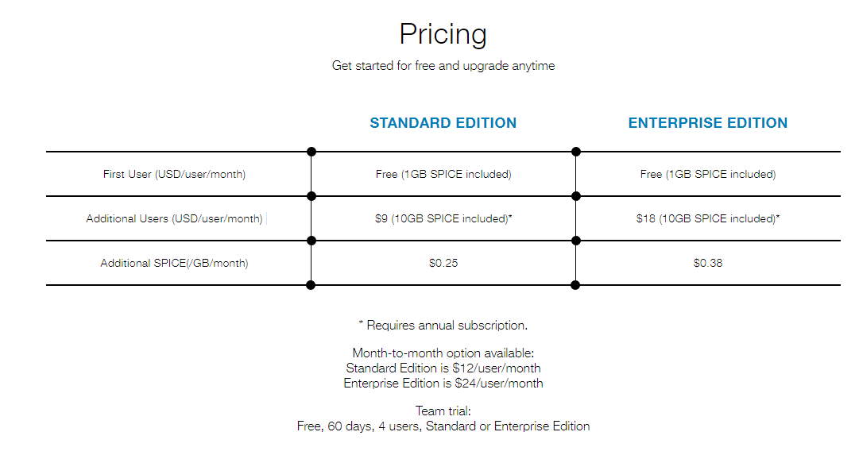
QuickSight Pricing

Slide 15
Resources
https:\\quicksight.aws
Videos
Marketing Content
Pricing
Online Documentation - http://docs.aws.amazon.com/quicksight/latest/user/welcome.html
Jen Underwood Course on Safari
Packt Books: Effective Business Intelligence with QuickSight (March 2017)
YouTube: Deep Dive on Amazon QuickSight (Jan 2017 AWS Tech Talk) https://youtu.be/gy1AcdJMsMk

Slide 16
http://docs.aws.amazon.com/quicksight/latest/user/enabling-access-rds.html

